Slide 1
Epidemic Modeling of the Onset of
Social Activities (EMOSA Models):
Applications to Adolescent
Religious Involvement
Joe Rodgers,
Andriy Koval, and Oleksandra Hararuk
SMEP, October 14, 2011

Slide 2
Acknowledgements
EMOSA models have been in development for almost 25 years, as a collaborative effort shared with my colleague David Rowe, University of Arizona – who died in February, 2002
Other collaborators – Grad students Sylvia Meseck-Bushey, Maury Buster, Amber Johnson
Collaborator on today’s work: Andriy Koval - current OU Quant grad student, Oleksandra Hararuk – OU ecological modeling lab, William Beasley - OU Health Sciences Center, Department of Pediatrics

Slide 3
Mathematical/Statistical Models
Mathematical/statistical models purport to represent the behavioral processes that are being modeled
Models have exactly two features
They match reality (fit)
They are simpler than that reality (parsimony)
Some models are designed as broad representations, portable models – e.g., regression, SEM, MLM
Some models are built to match a particular version of reality
EMOSA models are an example of the latter

Slide 4
Introduction
Epidemic
These models have been borrowed from the field of Epidemiology
They originated from May-Anderson models, which describe the spread bacteria, viruses, etc. through biological contagion
But our application involves social contagion
Models
Onset
Social
Activity

Slide 5
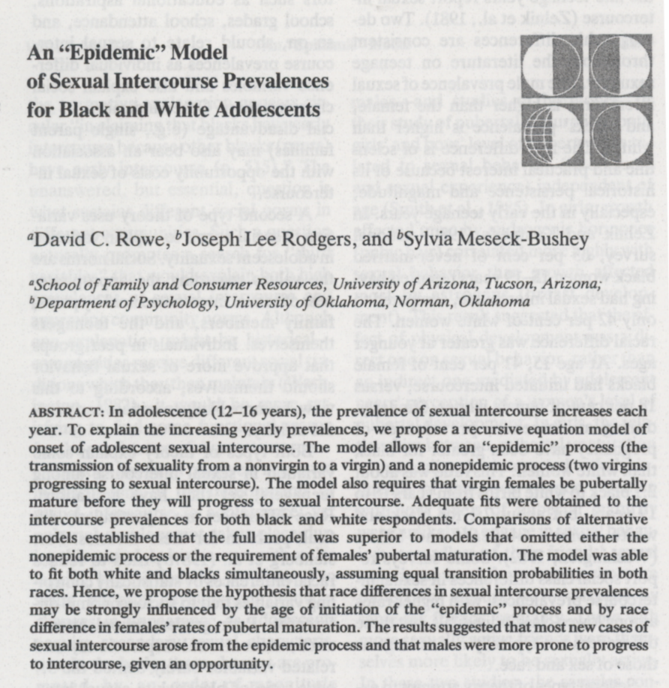
Past applications,
starting in 1989
Smoking
Drinking
Sexual Activity

Slide 6
Overview
EMOSA Sexuality Models
Simple two-sex EMOSA sexuality model
Inter-cohort contagion model
Developmental EMOSA sexual development model
EMOSA sexuality/pregnancy/STD model
EMOSA Smoking and Drinking Models
Simple one-sex EMOSA smoking/drinking model
Stagewise EMOSA smoking/drinking model
The mathematics of social contagion
New data - the Oklahoma Smoking/Drinking Survey
New empirical results

Slide 7
A Simple EMOSA Sexuality Model
Rowe, Rodgers, & Meseck-Bushey, 1989, Social Biology:
P_{t+1} = P_{t} + T (P_{t}) (1-P_{t}) + k (1- P_{t}) (1-P_{t})
Carry-Over Epidemic Non-epidemic
P_{t} is prevalence at time t
T is the epidemic transmission parameter
k is the non-epidemic transmission parameter
Notes:
Only two categories. If there are three categories – number of transmission parameters will increase to accommodate the structure

Slide 8
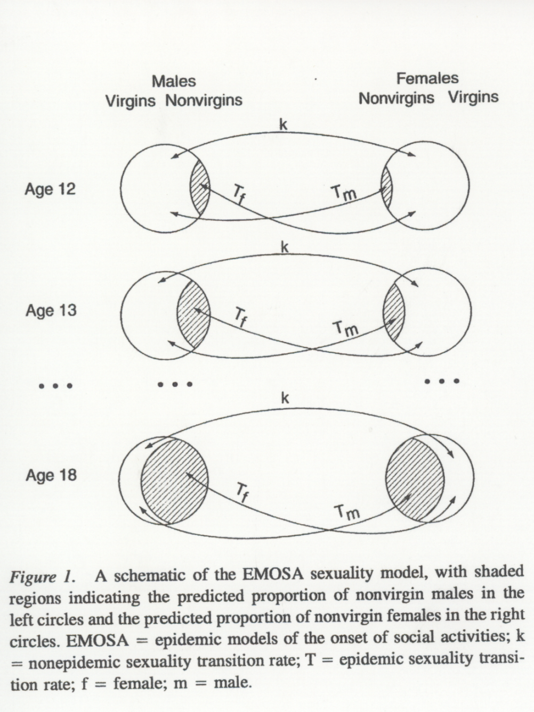
Figure 1, Rodgers, Rowe, & Buster, 1998, Developmental Psychology

Slide 9
EMOSA Smoking and Drinking Models
These work the same basic way that the sexuality models work, except that they’re single-sex models
Same types of filters, mixing adjustments, etc.
More focus on developmental stage models
Social congation versus General diffusion becomes important in the smoking/drinking models
NS
T
S
R
Im
Immune
Nonsmokers
Triers
Smokers
Recovered

Slide 10
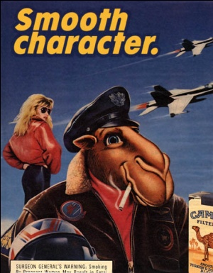



Contagion vs. Diffusion
Jack
Jack
Trier
Nonsmoker
Notes:
General diffusion – social influence is exerted through broader communication channels, like media, advertizing, literature, etc.

Slide 11
Contagion vs. Diffusion
Jack
Jack
Jack
Trier
Smoker
Nonsmoker
Notes:
Social contagion – social influence is passed from person to person

Slide 12
Work by David Rowe (Rowe et al, 1994) showed that onset of smoking is all about social contagion
But transition to regular smoking is all about general diffusion
In other words, kids start smoking because their friends encourage them to; they continue smoking because of the presence of a “smoking culture” in their families, on tv, in magazines, etc.
contagion
diffusion
NS
T
S
R
Im
Immune
Nonsmokers
Triers
Smokers
Recovered

Slide 13
These two processes are similar, but have tremendously different policy implications
E.g., consider the delivery of a pregnancy reduction campaign to inner-city adolescent girls
Social contagion implies intervene at the friendship/dyad level
General diffusion implies use an ad campaign

Slide 14
diffusion
contagion

Slide 15
From Rodgers, Rowe, & Buster (1998)

Slide 16
From Rodgers & Johnson (2007)

Slide 17
EMOSA Religious Involvement Model
In this new application, we posit the same type of social contagion – i.e., a social influence process that passes from person to person – as a potential for influencing religious behavior upon entry into college
We have longitudinal data, from the NLSY97, that reflects ongoing religious involvement behavior
Looking forward: Is there a visual tell-tale sign for free transitions?

Slide 18
Religious Involvement Data
National Longitudinal Survey of Youth (NLSY97)
Over 9,000 respondents
5,214 Included ( No missing data)
Age at 2000 : 16-20
Cohorts:
1980 – 1981 – 1982 – 1983 – 1984
Notes:
Five-year slice of population
So, first let’s talk about the structure of our new data, and later we will see how they relate to our EMOSA context

Slide 19
Religious Involvement Data
Q: “In the past year, how frequently did you attend a place of worship?”
8 | 'Everyday'
7 | 'Several times a week'
6 | 'About once a week'
5 | 'About twice a month'
4 | 'About once a month'
3 | 'Less than once a month'
2 | 'Once or twice'
1 | 'Never'
gOERS
Irregulars
Absentees
Notes:
Goers – church at least every Sunday, perhaps involved in choir or some other church activity, not necessarily zealously religious, socially oriented towards church
Irregulars – church every other Sunday ( struggling Christian), or maintaining nominal involvement with the church. Spectrum: from regularly skipping church to occasionally going to church
Non-goers – atheists, cultural Christians ( Easter, Christmas).

Slide 20
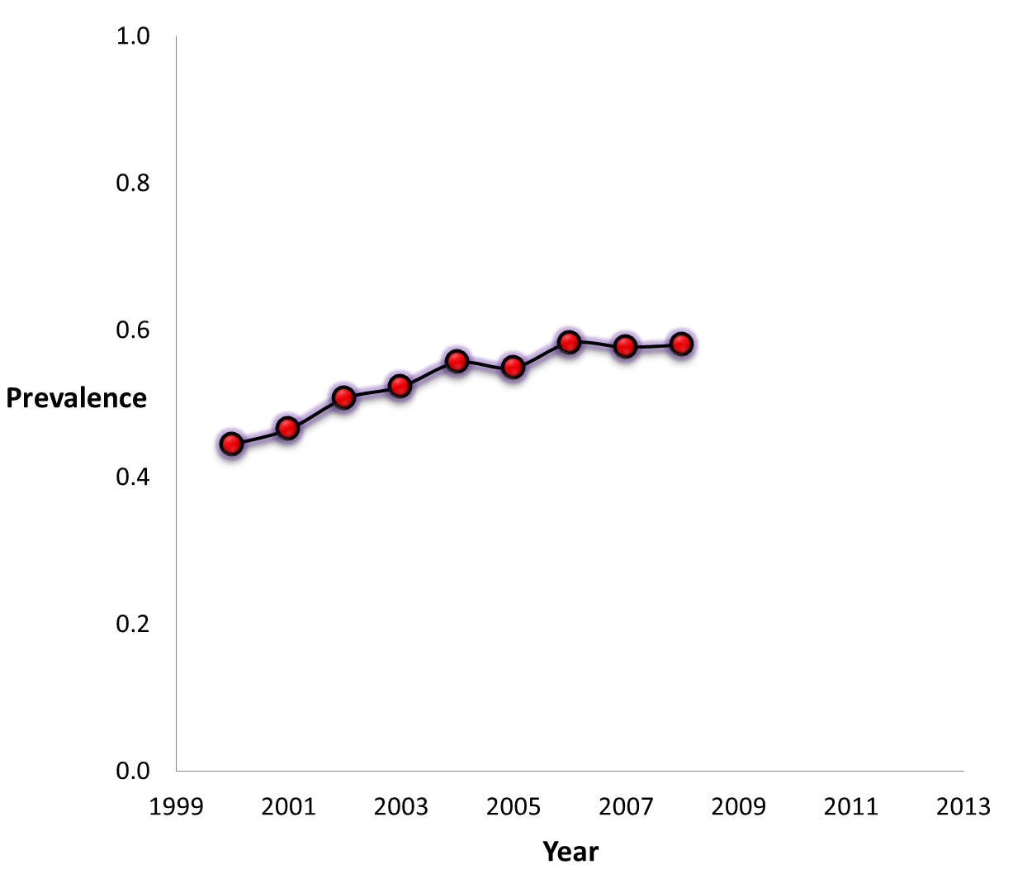
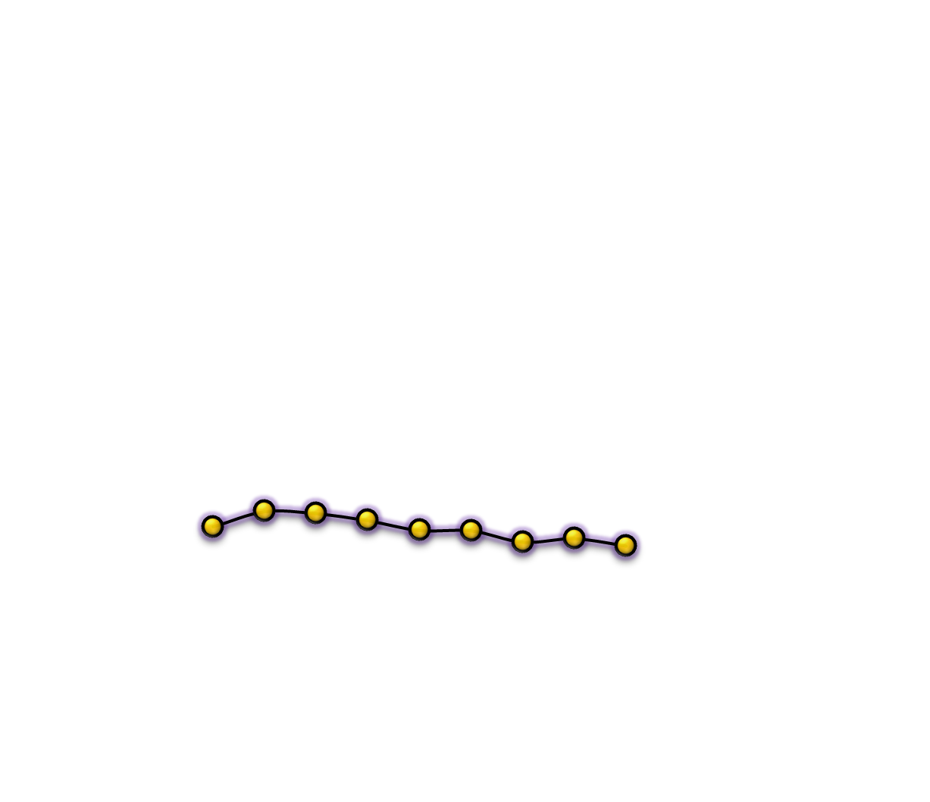
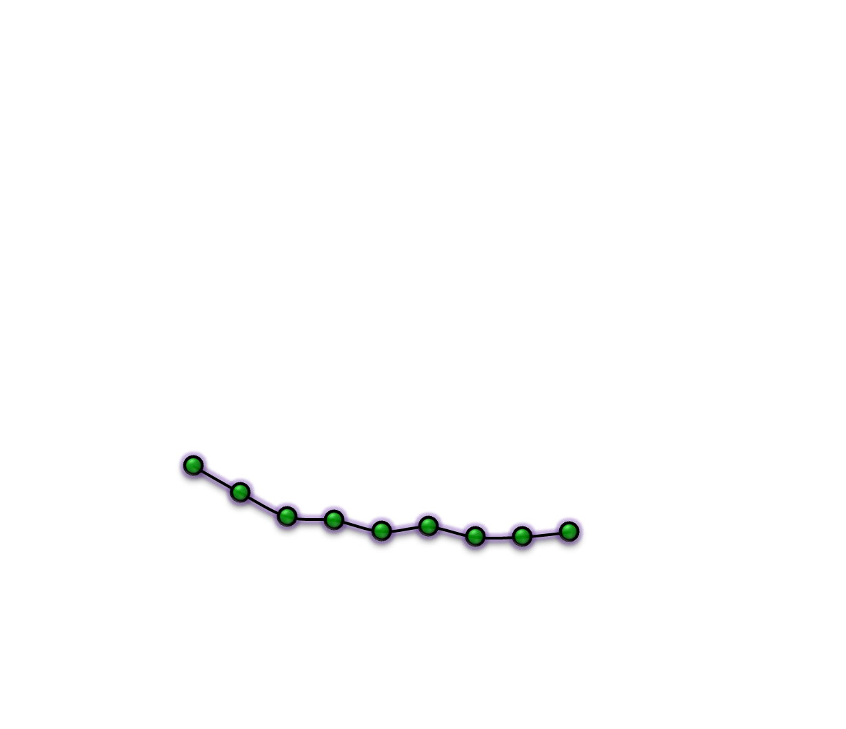
8 | 'Everyday';
7 | 'Several times a week'
6 | 'About once a week'
5 | 'About twice a month'
4 | 'About once a month'
3 | ‘LT once a month'
2 | 'Once or twice'
1 | 'Never'
.58
.44
.29
.24
.18
Notes:
So now we know
What categories of religious involvement are
What makes you a member of a category
We see that Nongoers become more prevalent with age
We se that Goers drop rapidly in numbers from year 2000 to 2003
Year effect?
Age\Lifecycle effect?
Let’s take that fact about cohorts out from the back of our heads

Slide 21
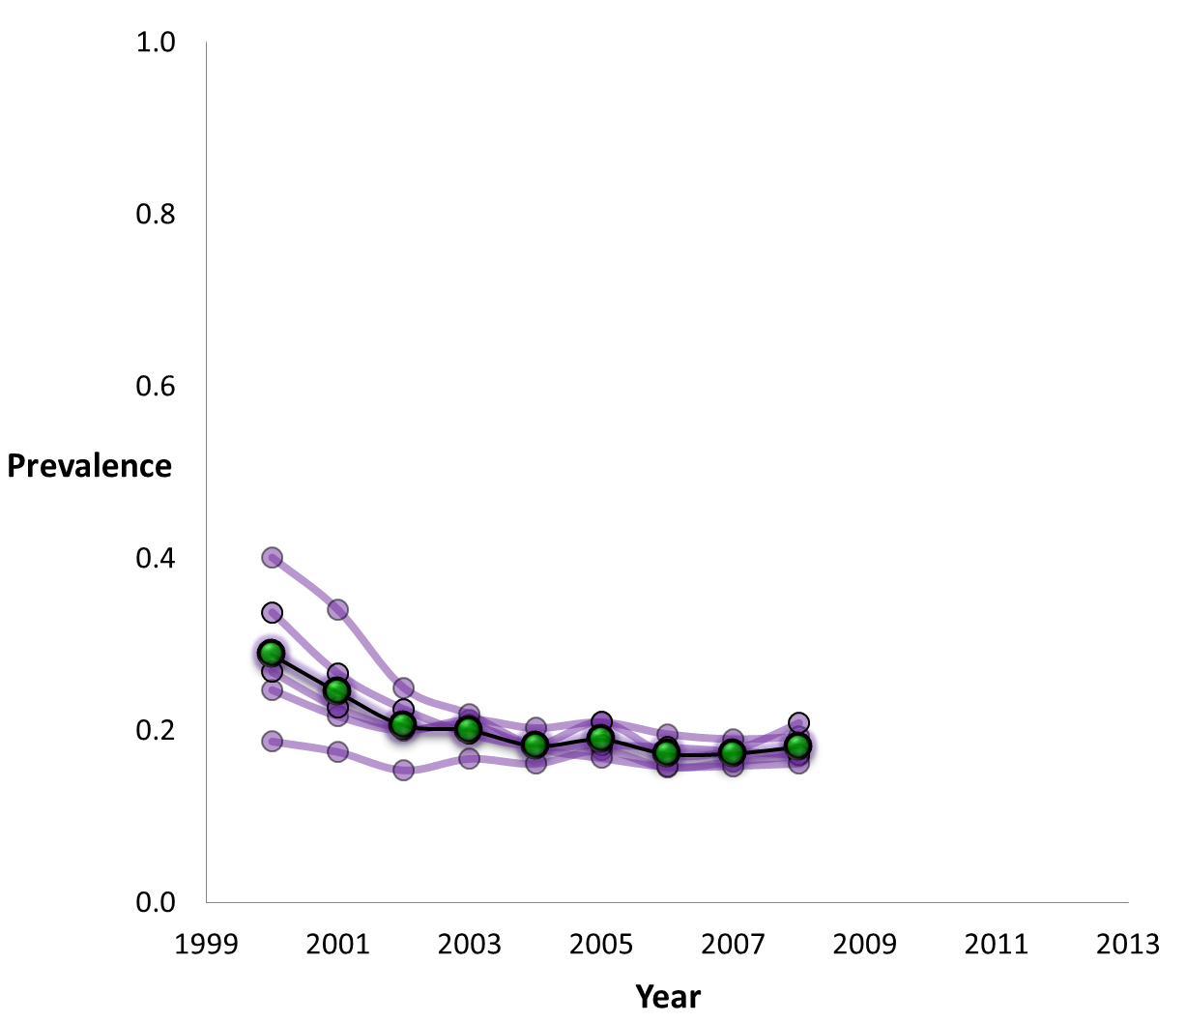
gOERS
8 | 'Everyday';
7 | 'Several times a week'
6 | 'About once a week'
16
Ages
20
24
20
28
24
Notes:
Age influences Goers only until 20
After you turn 20, your age does not influence your religious participation.
What does this mean? It means that if I were to pick up at random a person from this population, the younger he is, the more religiously active I expect him to be. But only below 20. After 20 years, AGE is a ineffective predictor or religious involvement.
As the age difference shifts along the continuum, it becomes less meaningful for religious involvement.

Slide 22
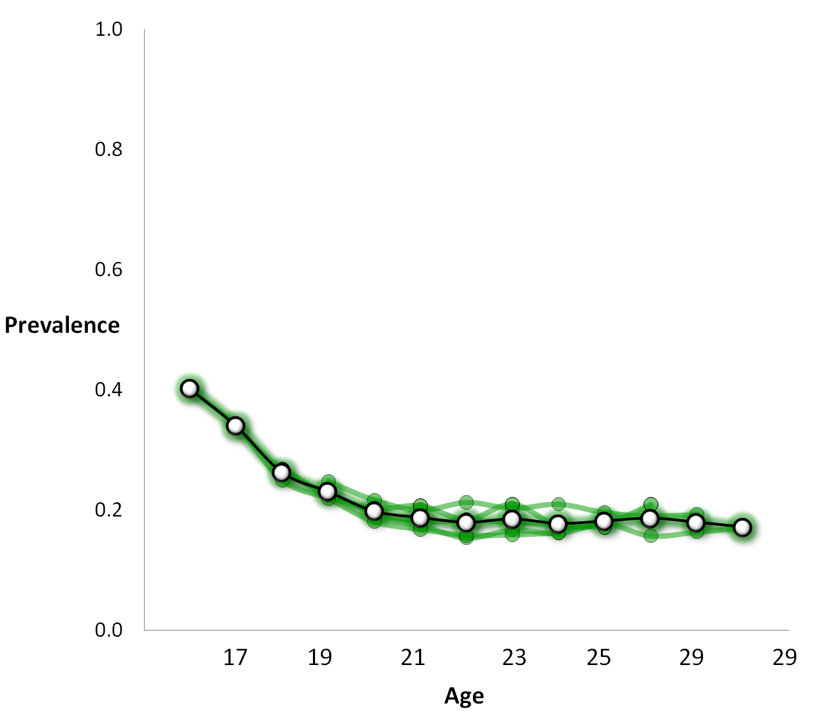
8 | 'Everyday';
7 | 'Several times a week'
6 | 'About once a week'
gOERS
.18

Slide 23
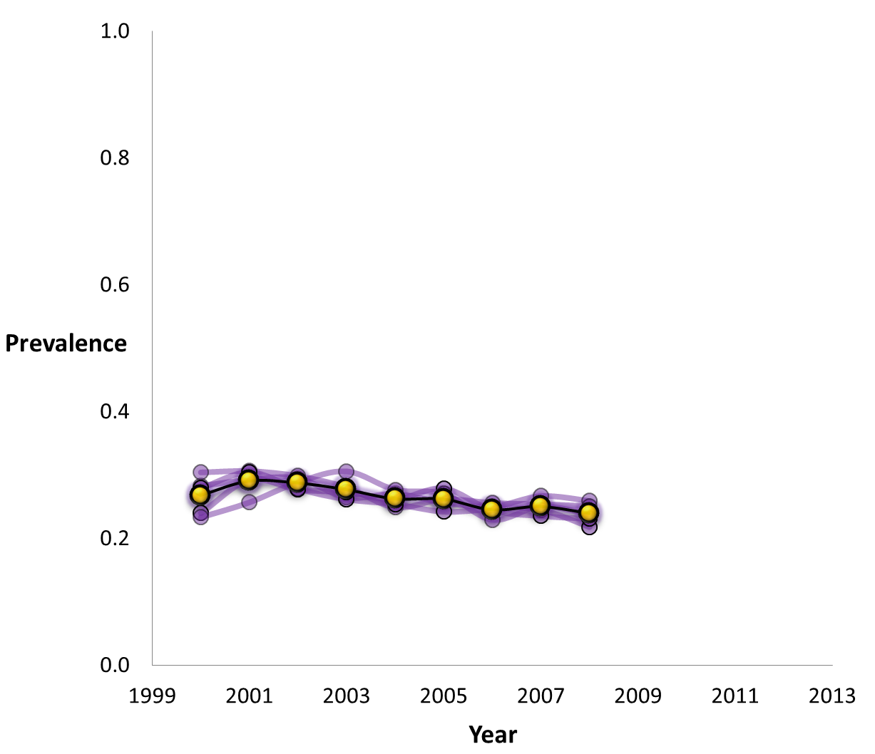
5 | 'About twice a month'
4 | 'About once a month'
3 | ‘LT once a month'
Irregulars
Notes:
IRREGULARS, unlike GOERS are not sensitive to AGE
Within the five-year slice of the population, the prevalence of IRREGULARS does not vary much with AGE.
MEANING: If we choose a member of population, the chances that he is a IRREGUAR stay the same regardless of subject’s age.
But you can see a “bump” at

Slide 24
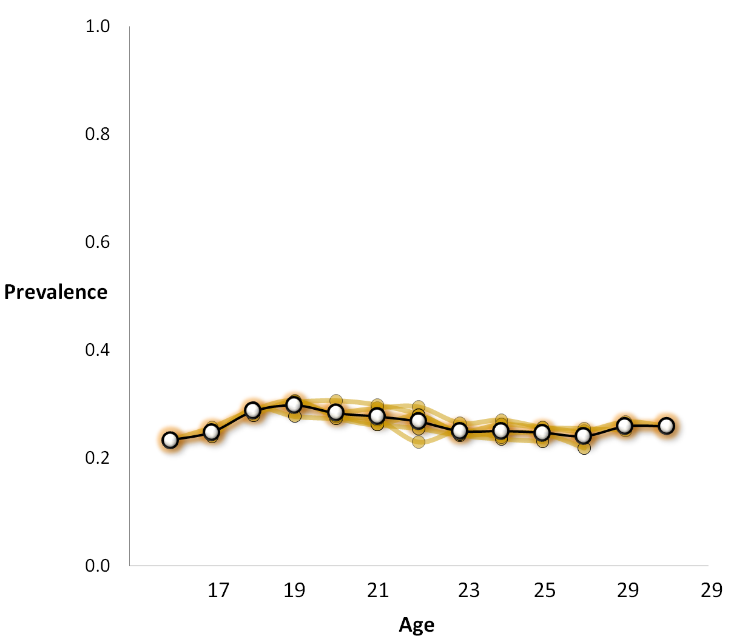
5 | 'About twice a month'
4 | 'About once a month'
3 | ‘LT once a month'
Irregulars
.27
Notes:
IRREGULARS, unlike GOERS are not sensitive to AGE
Within the five-year slice of the population, the prevalence of IRREGULARS does not vary much with AGE.
MEANING: If we choose a member of population, the chances that he is a IRREGUAR stay the same regardless of subject’s age.
But you can see a “bump” at 19 – LEAVING PARENT, COLLEDGE

Slide 25
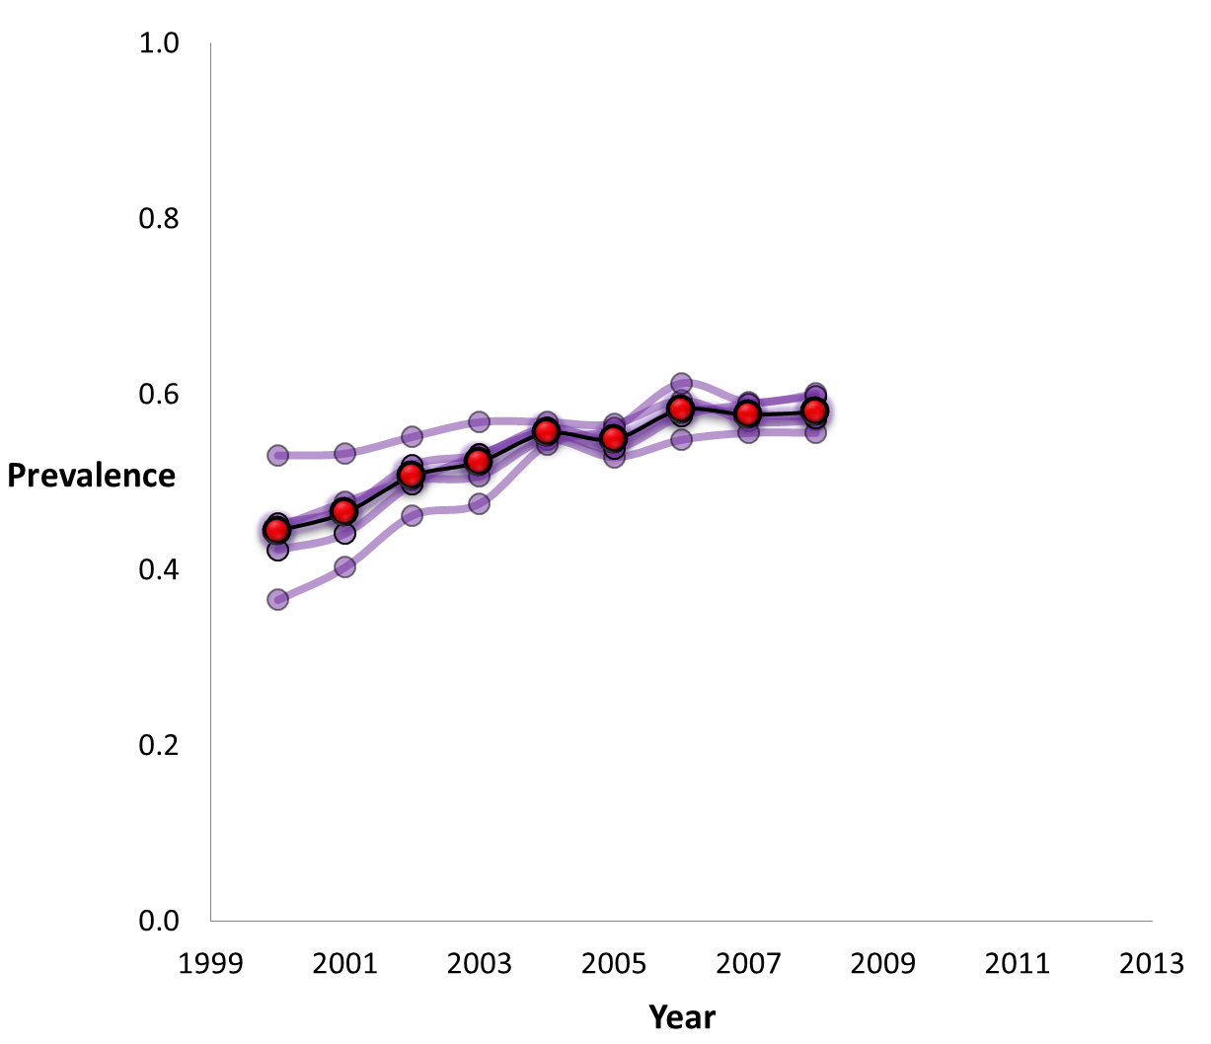
2 | 'Once or twice'
1 | 'Never'
20
Absentees
24

Slide 26
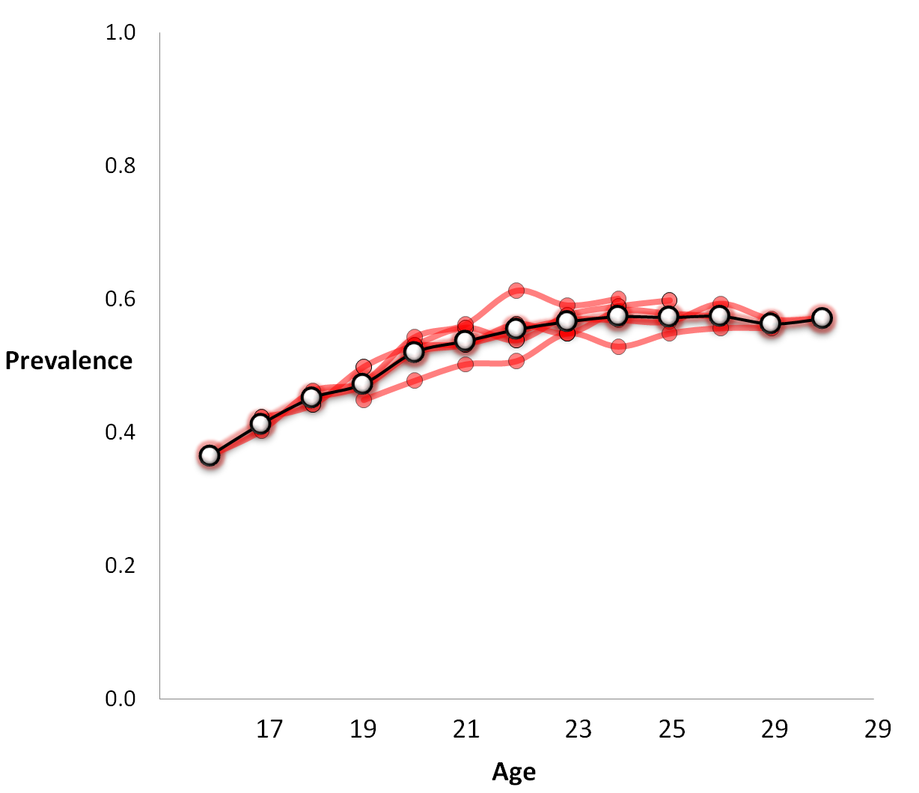
2 | 'Once or twice'
1 | 'Never'
.55
Absentees

Slide 27
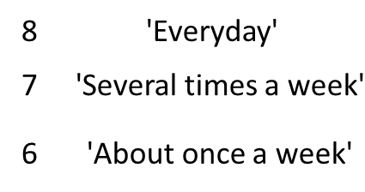
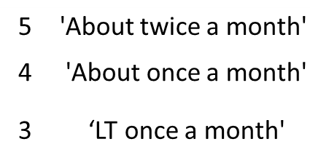
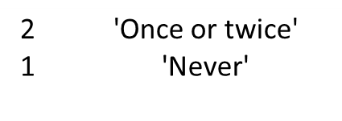
Notes:
Now, let’s begin our return to the EMOSA

Slide 29
Goers
Irregulars
Absentees

Slide 30
0.8
gOERS
0.8
0.6
0.6
0.4
0.4
0.2
0.2
2001
2003
2005
2007
0.8
Irregulars
0.8
0.6
0.6
0.4
0.4
0.2
0.2
2001
2003
2005
2007
0.8
Absentees
0.8
0.6
0.6
0.4
0.4
0.2
0.2
2001
2003
2005
2007

Slide 31
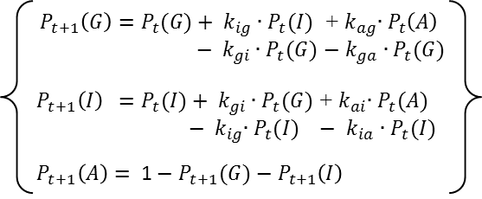
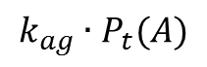
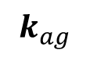
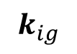
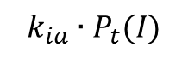
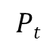
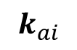
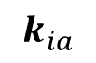
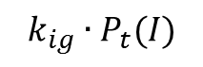
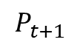
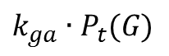
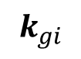
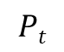
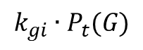
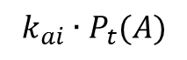
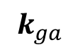
Specification : Diffusion
Starts as
meets
becomes
Goer
G
$$k_{gi}∙P_{t}(G)$$
$$k_{gi}$$
$$k_{ga}$$
$$k_{ga}∙P_{t}(G)$$
$$k_{ig}$$
I
$$k_{ia}$$
$$k_{ig}∙P_{t}(I)$$
Irregular
$$k_{ag}$$
$$k_{ai}$$
A
$$k_{ia}∙P_{t}(I)$$
$$k_{ag}∙P_{t}(A)$$
$$k_{ai}∙P_{t}(A)$$
Absentee
$$Pt$$
$$Pt$$
$$P_{t+1}$$

Slide 32
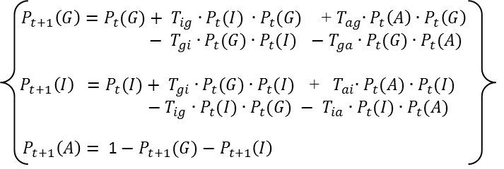
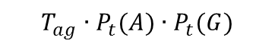
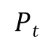
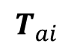

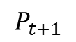
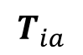
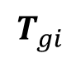
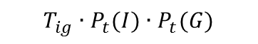
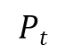
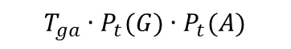
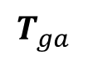
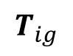
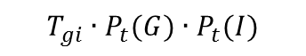
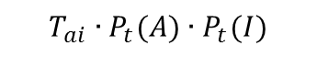
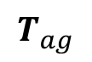
Specification : Contagion
Starts as
meets
becomes
G
$$T_{gi}$$
Goer
$$T_{ga}$$
$$T_{gi}∙P_{t}(G)∙P_{t}(I)$$
$$T_{ig}$$
I
$$T_{ia}$$
$$T_{ga}∙P_{t}(G)∙P_{t}(A)$$
$$T_{ig}∙P_{t}(I)∙P_{t}(G)$$
$$T_{ai}$$
A
Irregular
$$T_{ag}$$
$$T_{ia}∙P_{t}(I)∙P_{t}(A)$$
$$T_{ag}∙P_{t}(A)∙P_{t}(G)$$
$$T_{ai}∙P_{t}(A)∙P_{t}(I)$$
Absentee
$$Pt$$
$$Pt$$
$$P_{t+1}$$

Slide 33
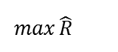
Contagion
.6
Bayesian MCMC
Chains : 5
Min Burn-In : 5,000
Min Retained: 15,000
.4
Prevalence
.2
$$\max{\hat{R}}$$
Cohort | PSRF
1980 | 1.00 | 1.00
1981 | 1.00 | 1.00
1982 | 1.00 | 1.00
1983 | 1.00 | 1.00
1984 | 1.00 | 1.00
.6
.4
.2
1982
1981
1980
2001
2003
2005
2007
2001
2003
2005
2007
2001
2003
2005
2007

Slide 34
Contagion
.6
G
.66
.48
.4
.34
I
.57
.2
.52
.42
A
.6
.4
.2
1982
1981
1980
2001
2003
2005
2007
2001
2003
2005
2007
2001
2003
2005
2007

Slide 35
Diffusion
.6
Bayesian MCMC
Chains : 5
Min Burn-In : 5,000
Min Retained: 15,000
.4
Prevalence
.2
$$\max{\hat{R}}$$
Cohort | PSRF
1980 | 1.01 | 1.03
1981 | 1.01 | 1.03
1982 | 1.01 | 1.02
1983 | 1.00 | 1.00
1984 | 1.00 | 1.00
.6
.4
.2
1982
1981
1980
2001
2003
2005
2007
2001
2003
2005
2007
2001
2003
2005
2007

Slide 36
Diffusion
.6
G
.43
.24
.4
.24
I
.29
.2
.10
.10
A
.6
.4
.2
1982
1981
1980
2001
2003
2005
2007
2001
2003
2005
2007
2001
2003
2005
2007

Slide 37
Do we have a winner?
Diffusion model works, but…
Simply better than Contagion
Treats all transitions as having the same nature
Flashback to smoking model: some processes might have different mode of spreading
Closer look at Diffusion vs. Contagion

Slide 38
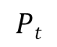
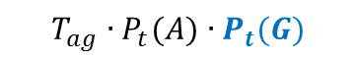
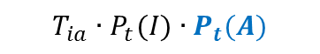





Diffusion vs. Contagion
Starts as
meets
becomes
Starts as
meets
becomes
Goer
Goer
$$k_{gi}∙P_{t}(G)$$
$$T_{gi}∙P_{t}(G)∙P_{t}(I)$$
$$k_{ga}∙P_{t}(G)$$
$$T_{ga}∙P_{t}(G)∙P_{t}(A)$$
$$k_{ig}∙P_{t}(I)$$
$$T_{ig}∙P_{t}(I)∙P_{t}(G)$$
Irregular
Irregular
$$k_{ia}∙P_{t}(I)$$
$$T_{ia}∙P_{t}(I)∙P_{t}(A)$$
$$k_{ag}∙P_{t}(A)$$
$$T_{ag}∙P_{t}(A)∙P_{t}(G)$$
$$k_{ai}∙P_{t}(A)$$
$$T_{ai}∙P_{t}(A)∙P_{t}(I)$$
Absentee
Absentee
$$Pt$$
$$Pt$$
$$P_{t+1}$$
$$Pt$$
$$Pt$$
$$P_{t+1}$$

Slide 39
Closer look: Diffusion vs. Contagion
The difference between the models

Slide 40
Hybrid Model
C_{ig}
C_{ag}
C_{gi}
C_{ga}
C_{gi}
C_{ai}
C_{ig}
C_{ia}

Slide 41
Contagion
.6
G
.66
.48
.4
.34
I
.57
.2
.52
.42
A
.6
.4
.2
1982
1981
1980
2001
2003
2005
2007
2001
2003
2005
2007
2001
2003
2005
2007

Slide 42
Diffusion
.6
G
.43
.24
.4
.24
I
.29
.2
.10
.10
A
.6
.4
.2
1982
1981
1980
2001
2003
2005
2007
2001
2003
2005
2007
2001
2003
2005
2007

Slide 43
Hybrid
.6
Bayesian MCMC
Chains : 5
Min Burn-In : 5,000
Min Retained: 15,000
.4
Prevalence
.2
$$\max{\hat{R}}$$
Cohort | PSRF
1980 | 1.03 | 1.03
1981 | 1.02 | 1.03
1982 | 1.01 | 1.01
1983 | 1.09 | 1.14
1984 | 1.09 | 1.08
.6
.4
.2
1982
1981
1980
2001
2003
2005
2007
2001
2003
2005
2007
2001
2003
2005
2007

Slide 44

Hybrid
0.8
gOERS
0.8
‘82
‘80
‘84
‘83
‘81
0.6
0.6
0.4
0.4
.5
0.2
0.2
2001
2003
2005
2007
0.8
Irregulars
0.8
0.6
0.6
0.4
0.4
0.2
0.2
2001
2003
2005
2007
0.8
Absentees
0.8
0.6
0.6
0.4
0.4
0.2
0.2
2001
2003
2005
2007

Slide 45
Hybrid
0.8
gOERS
0.8
‘82
‘80
‘84
‘83
‘81
0.6
0.6
0.4
0.4
.5
0.2
0.2
2001
2003
2005
2007
0.8
Irregulars
0.8
0.6
0.6
Parameter Value
0.4
0.4
0.2
0.2
2001
2003
2005
2007
0.8
Absentees
0.8
0.6
0.6
0.4
0.4
0.2
0.2
2001
2003
2005
2007

Slide 46
Substantive Conclusions
Abrupt changes in religiosity are getting less contagious with age
Moderate increase in religiosity has an noticeable contagious component
Overall: Change in religious behavior tends to become less contagious with age

Slide 47
Methodological Conclusions
EMOSA works for 3-categories
Free transitions among categories
Mixed model = most illuminating
Good convergences, stability
Verified by simulation studies
Reproduces data well
C-parameters can tell the nature of the transition
Successful novel application
Can plug in other behaviors

Slide 48
Q/A

